Slide 1

Exploratory Data Analysis on Marketing Campaign
Dinesh K

Slide 2
Objective: Analyzing the trends and results of multiple marketing campaigns.
Dataset Source: https://www.kaggle.com/datasets/jackdaoud/marketing-data
Tools used: Jupyter Notebook
Language and Packages used: Python (Pandas, NumPy, Matplotlib, Seaborn)

Slide 3
Data Cleaning
Clean data will ultimately increase overall productivity and allow for the highest quality information in decision-making.
The data is imported and checked for any irregularities and the dirty data is cleaned for smooth exploration.
The missing values are filled with 0.

Slide 4
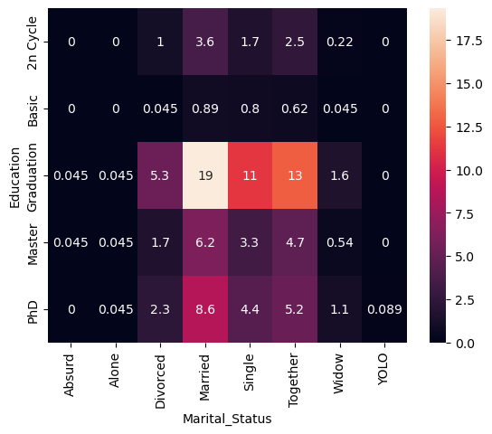
Key Insights: Marital Status and Education
Here, married (officially or informally) and single customers with secondary education consists the largest percentage of persons.
It can also be seen that people with the specified marital status are the most active customers.

Slide 5
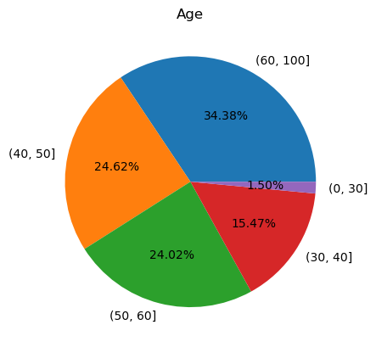
Key Insights: Age and Marketing Campaigns
People above age 40 are the most susceptible to marketing campaigns

Slide 6
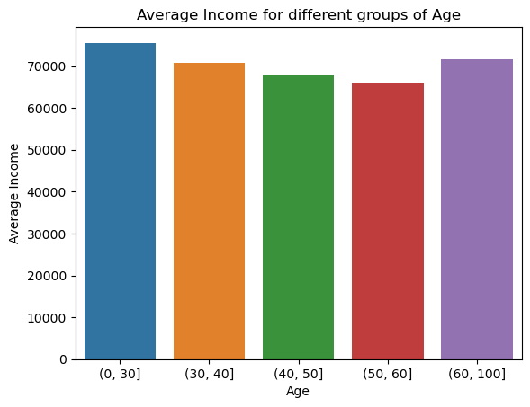
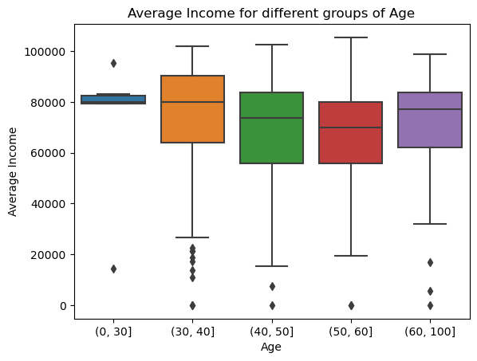
Key Insights: Income and Age
Young people and the elderly have the highest incomes.
People between the ages of 40 and 50 have the largest income disparities.
The maximum income in all groups is about the same except for young people.

Slide 7
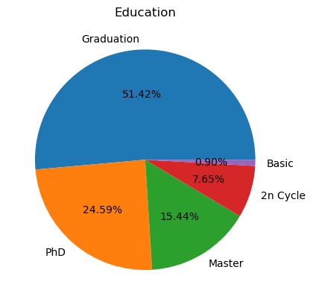
Key Insights: Education
Customers with secondary education, PhDs, and master's degrees are the most active and successful.

Slide 8
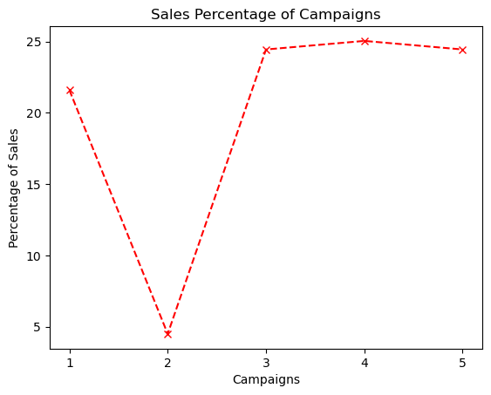
Key Insights: Campaign Success
The most successful were 1, 3, 4 and 5 marketing campaigns while 2nd campaign doesn’t perform well.
Their effectiveness is about the same level.

Slide 9
Summary
People above age 40 are the most susceptible to marketing campaigns.
Married and single customers with secondary education consists the largest percentage of Customers.
It can also be seen that people with the specified marital status are the most active customers.
Young people and the elderly have the highest incomes.
People between the ages of 40 and 50 have the largest income disparities.
The maximum income in all groups is about the same except for young people.
The most active customers are people with secondary education, then - PhDs, and people with a master's degree.
The most successful were 1, 3, 4 and 5 marketing campaigns. Their effectiveness is about the same level.

Slide 10
Conclusion
The explored trends provide significant insights for future marketing strategies such as,
Targeting customers above age 40.
Tailoring campaigns for different educational backgrounds.
Maximizing impact by leverage the insights gained from successful campaigns.
Overall, these trends provide valuable guidance for future marketing strategies.

